Slide 1
CS 608 Algorithms
Week 11 Dr. Tom Schmidt

Slide 2
Week 11 Agenda
Graph Algorithms
Minimum Spanning Trees
Menage a 10 plus 1 (quiz)
Wrap-up and review

Slide 3
Week 11 Agenda
Квиз
MST: B/F, Dijkstra
All Pairs Shortest Paths
Flow
Wrap-up and review

Slide 4
квиз
1) What is the fundamental connection between building a minimum spanning tree and finding the maximum flow in a flow network?
2) Dijkstra’s algorithm does not run correctly with negative weights. Why?
3) Sketch a graph that has negative-weighted edges that Dijkstra’s algorithm DOES work with.

Slide 5
Bellman/Ford and Dijkstra
From Here

Slide 6
All Pairs Shortest Paths
From Here

Slide 7
Flow
From Here
Applications from Here

Slide 8
Google Interview: Goethe and BMW
Something on graphs, please

Slide 9
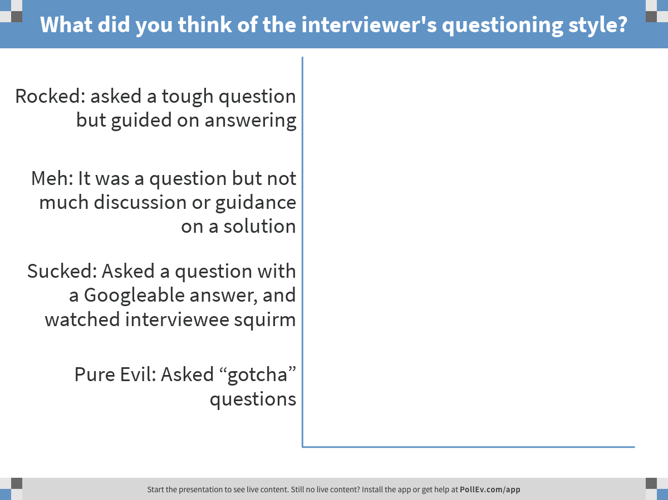
Notes:
What did you think of the interviewer's questioning style?
https://www.polleverywhere.com/multiple_choice_polls/gXPkEw1cpnly2ho

Slide 10
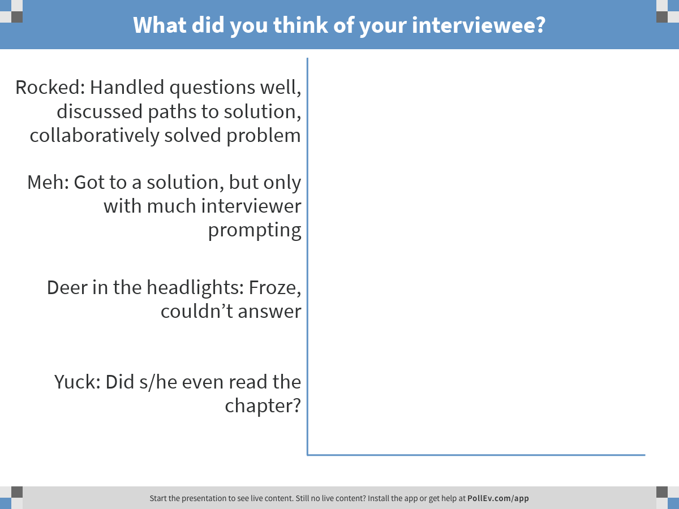
Notes:
What did you think of your interviewee?
https://www.polleverywhere.com/multiple_choice_polls/2Bcwzs8oRbfzQ4C

Slide 11
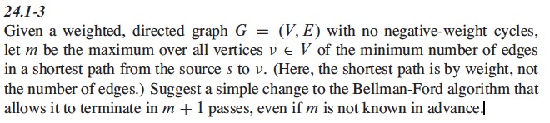
Problem 24.1-3 (Team Brandenburg)

Slide 12
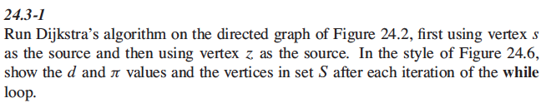
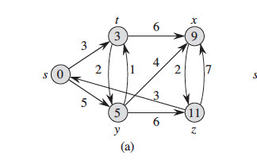
Problem 24.3-1

Slide 13
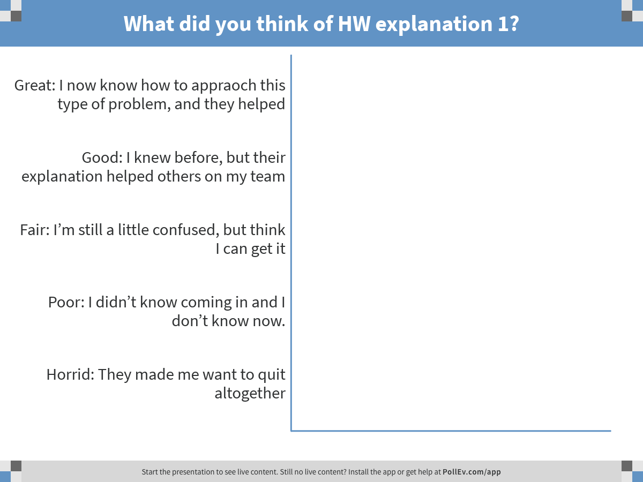
Notes:
What did you think of HW explanation 1?
https://www.polleverywhere.com/multiple_choice_polls/8vmrgZ3VhcBHQvH

Slide 14
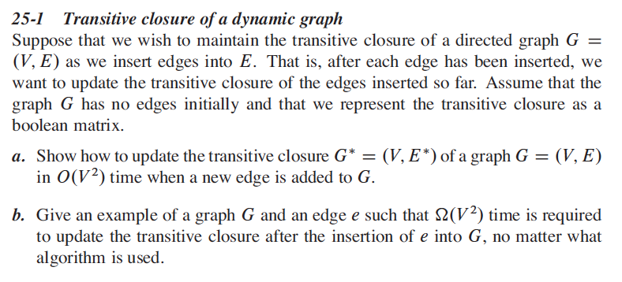
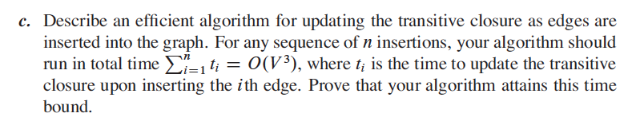
Problem 25-1 (Team Neuschwanstein)

Slide 15
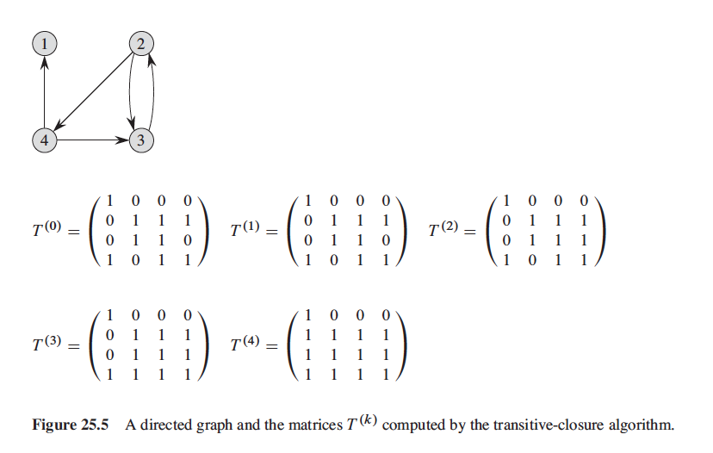
25-1

Slide 16
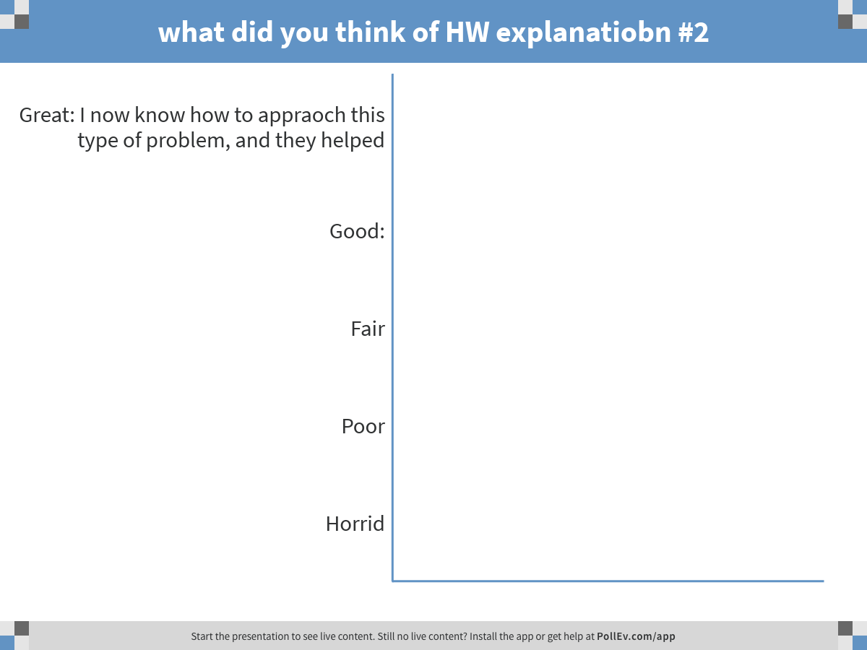
Notes:
what did you think of HW explanatiobn #2
https://www.polleverywhere.com/multiple_choice_polls/BL1zpHfb2mm0Ruz

Slide 17
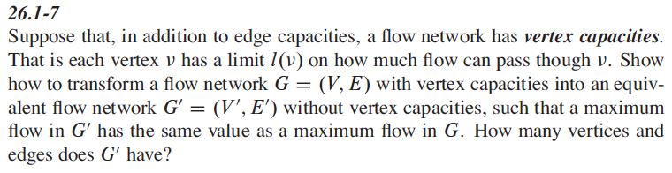
Problem 26.1-7 (Team Hamburg)

Slide 18
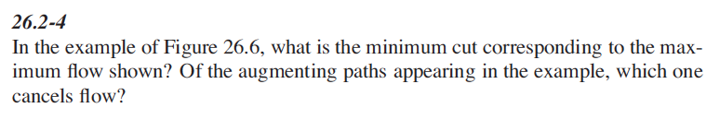
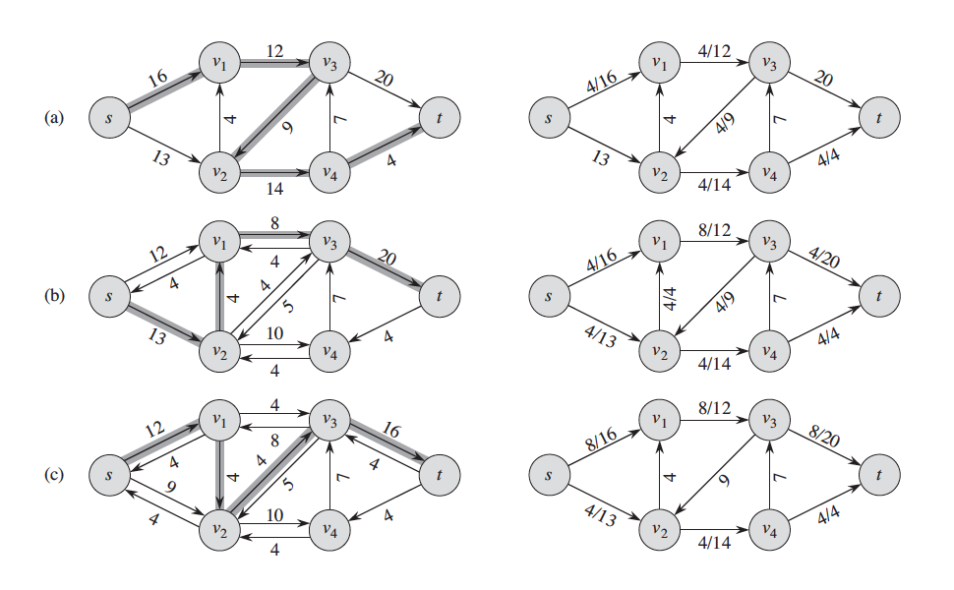
Problem 26.2-4

Slide 19
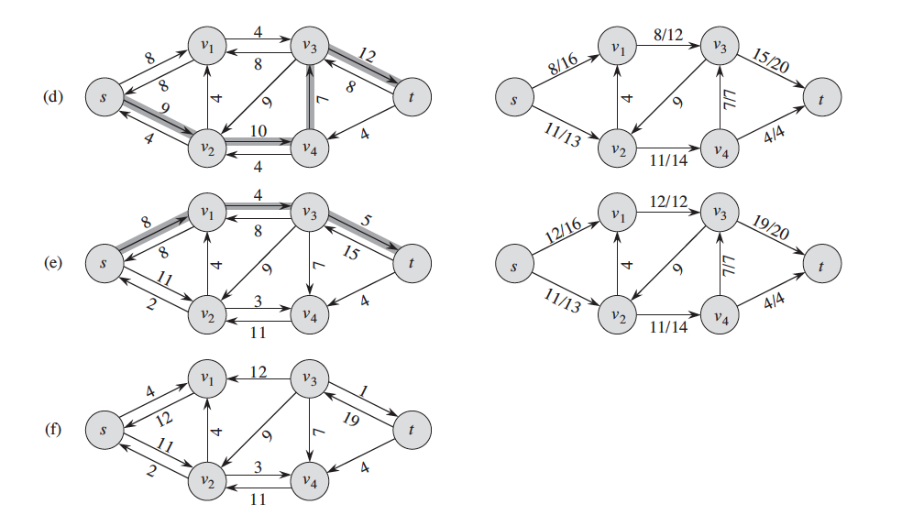
Problem 26.2-4

Slide 20
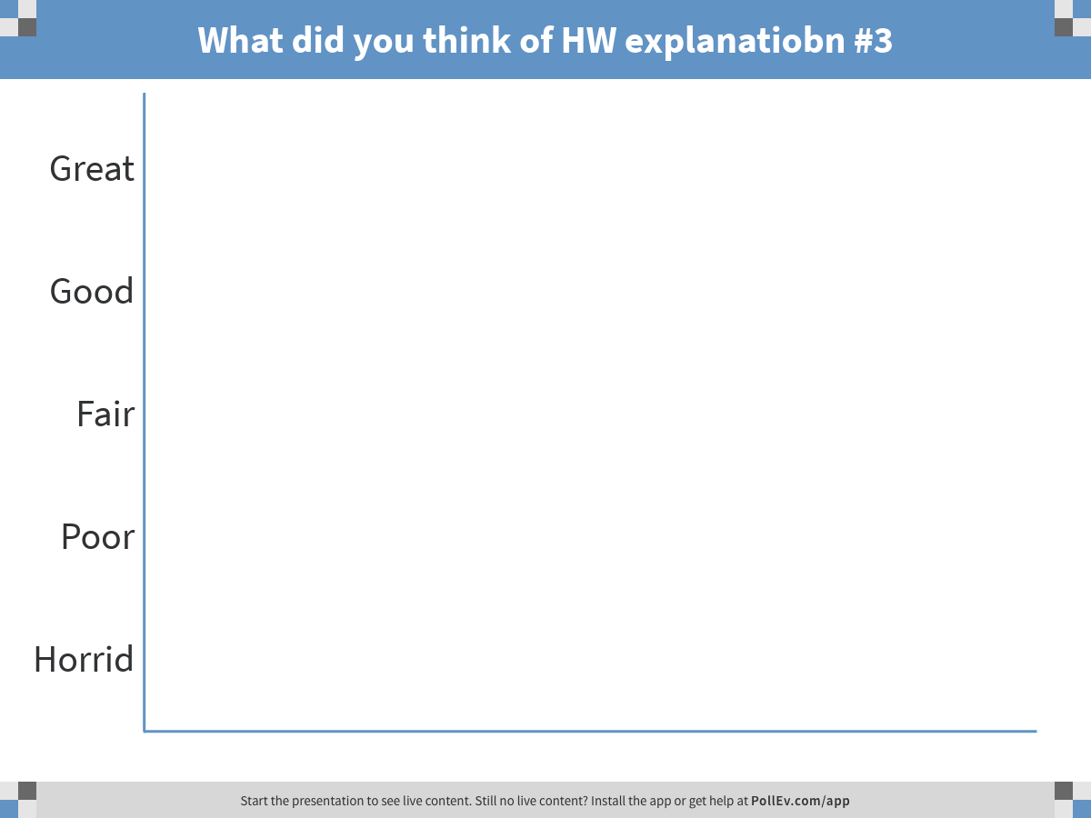
Notes:
What did you think of HW explanatiobn #3
https://www.polleverywhere.com/multiple_choice_polls/Yafw9lfl8l8gPr8

Slide 21
Wrap-up and review
Answer: Did you have enough time with graph algorithms?
Next Week:
We leave the land of Polynomial Algorithms
NPC
Week After: Dealing with NPC
Thank you and 早抖 (jóutáu)

